Slide 1
1. Binary System
Digital system – process data in a binary form, a system that manipulates discrete elements of
information represented internally in binary form
↑ signal (binary) –bit (binary digit)
discrete element

Slide 2
Number System
Decimal number expression
representations of a number in a different radix are said to be equivalent if
they are the same decimal representation
decimal → number in base r
integer part & fraction part
integer part – ‘r’ 로 나누기
fraction part – ‘r’ 로 곱하기
a₅a₄a₃a₂a₁a₀.a₋₁a₋₂a₋₃
= a_{n}r^{n}+a_{n-1}r^{n-1}+...+a₂r²+a₁r+a₀+a₋₁r⁻¹+a₋₂r⁻²+...+a_{-m}r^{-m}
7392 = 7 × 10³ + 3 × 10² + 9 × 10¹ +2 × 10⁰
(11010.11)₂ =1×2⁴+1×2³+0×2²+1×2¹+0×2₀+1×2₋₁+1×2₋₂
= (26.75)₁₀
(231.463)₈ = 2×8²+ 3×8¹+ 1×8⁰+ 4×8⁻¹+ 6×8⁻²+ 3×8⁻³
6C7.3A= 6×16² + C×16¹ + 7×16⁰ + 3×16⁻¹ + A×16⁻²
Numbers | Radix(r) | Number Conventions
Binary | 2 | 0, 1
Octal | 8 | 0, 1, ..., 6, 7
Decimal | 10 | 0, 1, ...,, 7, 8, 9
Hexadecimal | 16 | 0, 1, ..., 8, 9, A, B, C, D, E, F

Slide 3
Binary Number
Augend | 101101 | Minuend: | 101101 | Multiplicand: | 1011
Addend | +100111 | Subtrahend: | -100111 | Multiplier: | *101
sum | 1010100 | Difference: | 000110 |  | 1011
 |  |  |  |  | 0000
 |  |  |  |  | 1011
 |  |  |  | Product: | 110111

Slide 4
Number Base Conversions
Ex 1-1) Convert decimal 41 to binary.
answer : (41)10 = (a₅a₄a₃a₂a₁a₀)₂ = (101001)₂
Integer | Remainder
41
20 | 1
10 | 0
5 | 0
2 | 1
1 | 0
0 | 1
 | Integer Quotient |  | Remainder | Coefficient
41/2 = | 20 | + | ½ | a₀ = 1
20/2 = | 10 | + | 0 | a₁ = 0
10/2 = | 5 | + | 0 | a₂ = 0
5/2 = | 2 | + | ½ | a₃ = 1
2/2 = | 1 | + | 0 | a₄ = 0
1/2 = | 0 | + | ½ | a₅ = 1
Answer
=101001

Slide 5
Number Base Conversions
Ex 1-2) Convert decimal 153 to octal.
Ex 1-3) Convert (0.6875)10 to binary.
153
19 | 1
2 | 3
0 | 2 = (231)₈
 | Integer |  | Fraction | Coefficient
0.6875*2 = | 1 | + | 0.3750 | a₋₁ = 1
0.3750*2 = | 0 | + | 0.7500 | a₋₂ = 0
0.7500*2 = | 1 | + | 0.5000 | a₋₃ = 1
0.5000*2 = | 1 | + | 0.0000 | a₋₄ = 1
Answer:(0.6875)10 = (0.a₋₁a₋₂a₋₃a₋₄)₂ = (0.1011)₂
until the fraction becomes 0 or until the number of digits has sufficient accuracy

Slide 6
Number Base Conversions
Ex 1-4) Convert (0.513)10 to octal.
 | Integer |  | Fraction | Coefficient
0.513*8 = | 4 | + | 0.104 | a₋₁ = 4
0.104*8 = | 0 | + | 0.832 | a₋₂ = 0
0.832*8 = | 6 | + | 0.656 | a₋₃ = 6
0.656*8 = | 5 | + | 0.248 | a₋₄ = 5
Answer:(0.513)10 = (0.a₋₁a₋₂a₋₃a₋₄)₂ = (0.4065)₈
until the fraction becomes 0 or until the number of digits has sufficient accuracy

Slide 7
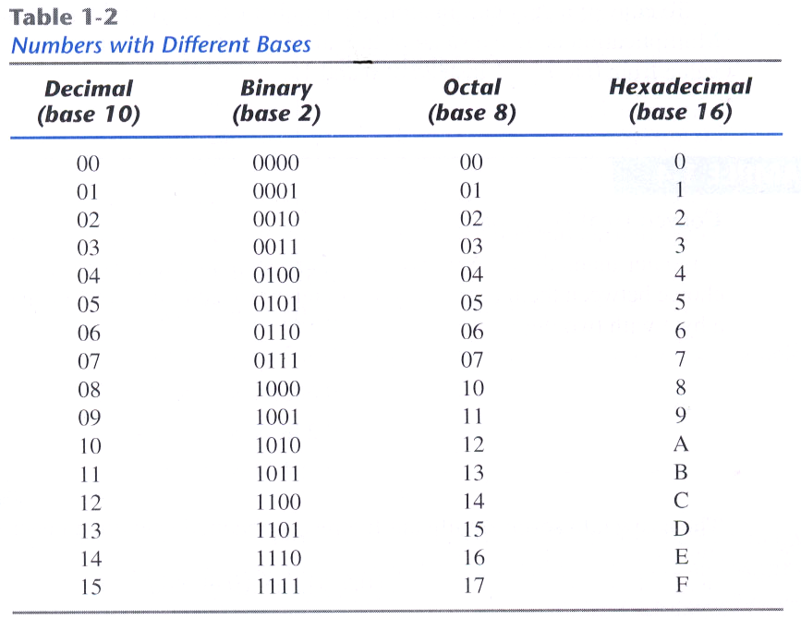
Octal and Hexadecimal Numbers
( 10 110 001 101 011 . 111 100 000 110 )₂ = (26153.7406)₈
2 6 1 5 3 7 4 0 6
( 10 1100 0110 1011 . 1111 0010 )₂ = (2C6B.F2)₁₆
2 C 6 B F 2
hexa – easier to recognize

Slide 8
Converting Between Base 16 and Base 2
(2C6B)₁₆=( 10 1100 0110 1011 )₂
2 C 6 B
Conversion is easy!
Determine 4-bit value for each hex digit
Note that there are 2⁴ = 16 different values of four bits
Easier to read and write in hexadecimal.
Representations are equivalent!

Slide 9
Converting Between Base 16 and Base 8
(2C6B)₁₆=( 10 1100 0110 1011 )₂
2 C 6 B
(26153)₈=( 10 110 001 101 011 )₂
2 6 1 5 3
1.Convert from Base 16 to Base 2
2. Regroup bits into groups of three starting from right
3. Ignore leading zeros
4. Each group of three bits forms an octal digit.

Slide 10
How to represent signed Numbers
Plus and minus sign used for decimal numbers
For computers, desirable to represent everything as bits.
Three types of signed binary number representations: signed magnitude, 1’s complement, 2’s complement.
In each case: left-most bit(MSB) indicates sign: positive (0) or negative (1).

Slide 11
Number Representation
n-bits binary number
MSB : singed(+;positive,0) or unsinged (-;negative,1)
(n-1) bit :magnitude
Maxim represent integers in the range
-2^{n-1} <= N <= 2^{n-1}-1
Consider signed magnitude:
00001100₂ = 12₁₀
10001100₂ = -12₁₀

Slide 12
Signed Binary Numbers
Ex) The number 9 represented in binary with eight bit
+9 : 00001001
-9 : 10001001 (signed-magnitude representation)
11110110 (signed-1’s-complement representation)
11110111 (signed-2’s-complement representation)

Slide 13
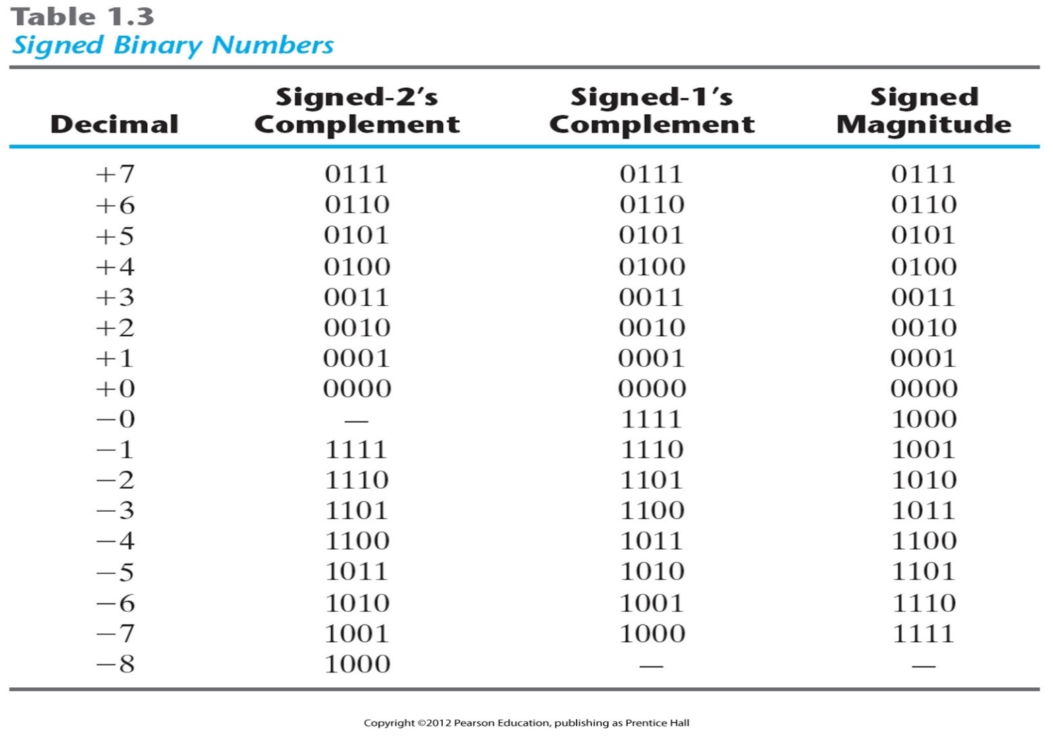
Signed Binary Numbers
signed magnitude : + → - by changing only the sign bit in the MSB from 0 to 1
signed 1’s complement : by complementing all the bits including the sign bit
signed 2’s complement : signed 1’s complement + 1
complement method > magnitude method : separate handling of the sign and the magnitude is awkward in computer. so, complement is normally used

Slide 14
Complements – Diminished Radix Complement
r’s complements of N is r^{n}-N
(r-1)’s complements of N is (r^{n}-1)-N
: r진법 n자리수의 N의 보수
r=10, r-1=9, 9’complements of N is (10^{n}-1)-N
Ex) the 10’s complements of 567 is 1000 - 567 = 433
the 9’s complements of 567 is 999 - 567 = 432
For binary number, r=2, r-1=1
Ex) the 1’s complements of 00000011 is 11111111 - 00000011 = 11111100
the 2’s complements of 00000011 is 100000000 - 00000011 = 11111101
The one’s complement of a binary number involves inverting all bits.
The two’s complement of a binary number involves inverting all bits and adding 1
complement – simplify the subtraction operation , simplify the logical manipulation

Slide 15
Signed Binary Numbers
Arithmetic Addition
- signed-magnitude system follows the rules of ordinary arithmetic.
- signed-complement system requires only addition.
Arithmetic Subtraction
(±A)-(+B) = (±A)+(-B)
(±A)-(-B) = (±A)+(+B)
signed-magnitude addition:
1. if the sign is same
1) we add the two magnitudes
2) give the sum the common sign
2. if the sign is different
1) larger magnitude – smaller magnitude
2) give the subtraction the larger number’s sign
+6 |  | 00000110 |  | -6 |  | 11111010
+13 |  | 00001101 |  | +13 |  | 00001101
+19 |  | 00010011 |  | +7 |  | 00000111
+6 |  | 00000110 |  | -6 |  | 11111010
-13 |  | 11110011 |  | -13 |  | 11110011
-7 |  | 11111001 |  | -19 |  | 11101101

Slide 16
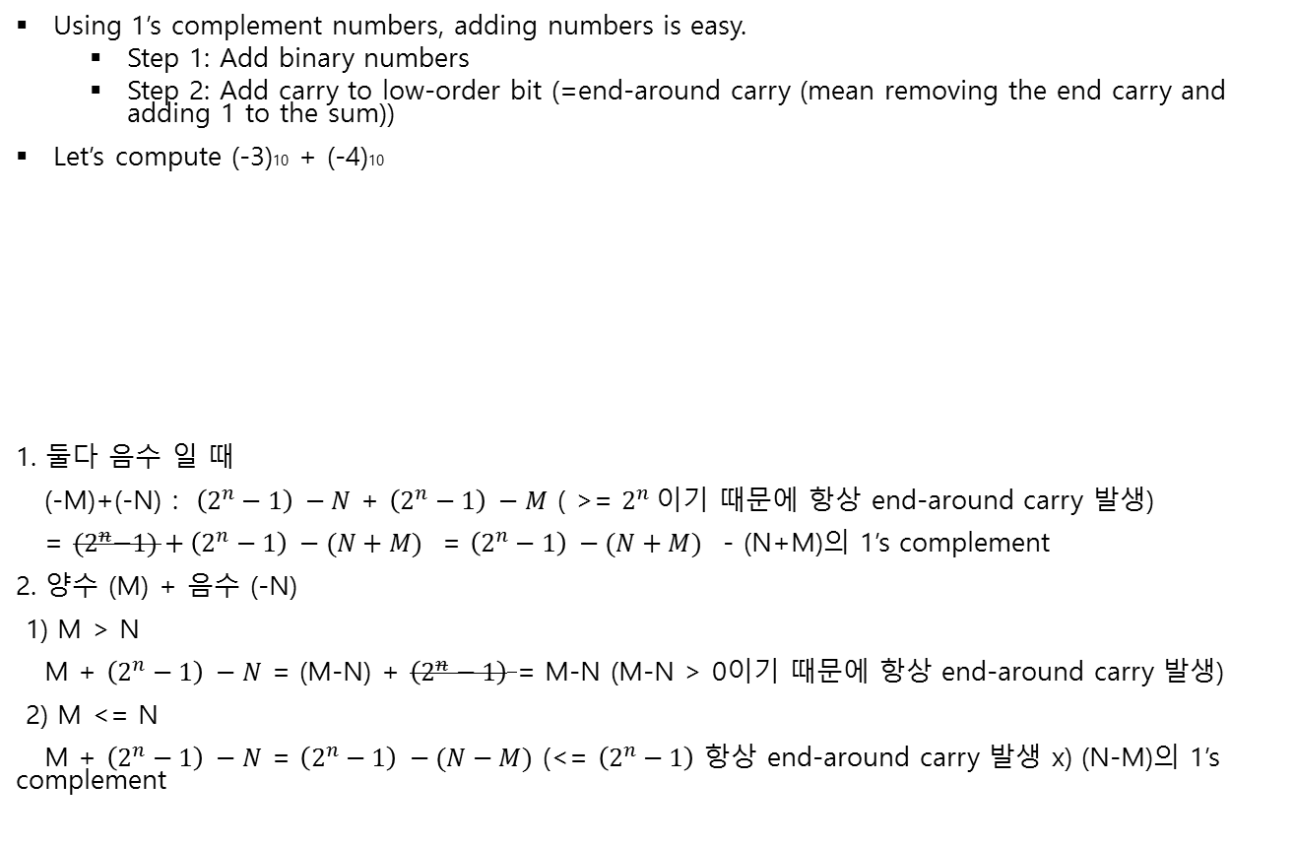
Complements – Addition with Complements
Using 1’s complement numbers, adding numbers is easy.
Step 1: Add binary numbers
Step 2: Add carry to low-order bit (=end-around carry (mean removing the end carry and adding 1 to the sum))
Let’s compute (-3)10 + (-4)10
1. 둘다 음수 일 때
(-M)+(-N) :$\left(2^{n}−1\right) −N$ + $\left(2^{n}−1\right) −M$ ( >= $2^{n} 이$기 때문에 항상 end-around carry 발생)
= ${(2}^{n}−1)+\left(2^{n}−1\right) −(N+M)$ = $\left(2^{n}−1\right) −(N+M)$ - (N+M)의 1’s complement
2. 양수 (M) + 음수 (-N)
1) M > N
M + $\left(2^{n}−1\right) −N$ = (M-N) + $\left(2^{n}−1\right)$ = M-N (M-N > 0이기 때문에 항상 end-around carry 발생)
2) M <= N
M + $\left(2^{n}−1\right) −N$ = $\left(2^{n}−1\right) −(N−M)$ (<= $\left(2^{n}−1\right)$ 항상 end-around carry 발생 x) (N-M)의 1’s complement
X = | 1100
1’s complement of Y = | +1011
Sum = | 10111
Add Carry= | 1
Final result = | 1000

Slide 17

Complements – Addition with Complements
Using 2’s complement numbers, adding numbers is easy.
Step 1: Add binary numbers
Step 2: Ignore carry bit
Let (-5)+5
1. 둘다 음수 일 때
(-M)+(-N) :$\left(2^{n}\right) −N$ + $\left(2^{n}\right) −M$ ( >= $2^{n} 이$기 때문에 항상 end-around carry 발생)
= ${(2}^{n})+\left(2^{n}\right) −(N+M)$ = $\left(2^{n}\right) −(N+M)$ - (N+M)의 2’s complement
2. 양수 (M) + 음수 (-N)
1) M >= N
M + $\left(2^{n}\right) −N$ = (M-N) + $\left(2^{n}\right)$ = M-N (M-N >= 0이기 때문에 항상 end-around carry 발생)
2) M < N
M + $\left(2^{n}\right) −N$ = $\left(2^{n}\right) −(N−M)$ (<= $\left(2^{n}−1\right)$ 항상 end-around carry 발생 x) (N-M)의 2’s complement
X = | 1011
2’s complement of Y = | +0101
Sum = | 10000
Ignore Carry=
Final result = | 0000

Slide 18
Complements – Subtraction with Complements
Using 1’s complement numbers, subtracting numbers is easy
Step 1: Take 1’s complement of 2nd operand
Step 2: Add binary numbers
Step 3: Add carry to low order bit
Let compute 12₁₀-1₁₀
X = | 01100
Y = | -00001
 | 01100
1’s complement add = | 11110
result = | 101010
Add carry | + 1 01011

Slide 19
Complements – Subtraction with Complements
Using 2’s complement numbers, subtracting numbers is easy
Step 1: Take 1’s complement of 2nd operand
Step 2: Add binary numbers
Step 3: Ignore carry bit
Let compute 12₁₀-1₁₀
X = | 01100
Y = | +11111
result = | 101011
Ignore carry | 01011

Slide 20
Complements –Overflow
Let’s compute (5)₁₀ +(6)₁₀.
(5)₁₀ = +(101)₂ = (0101)₂
(6)₁₀ = +(110)₂= (0110)₂
Adding these two 4-bit codes…
There is no carry bit and sign bit is seen to be one, indicating an incorrect result, which is what we expect (1011)₂ = (11)₁₀ but (1011)₂ = -(5)₁₀.
Let’s compute (-6)₁₀ +(-7)₁₀.
Adding these two 4-bit codes…
Discarding the carry bit , the sign bit is seen to be zero, indicating an incorrect result. (0011)₂ = (3)₁₀

Slide 21
Complements –Overflow
If an addition operation produces a result that exceeds the range of the number system, overflow is said to occur.

Slide 22
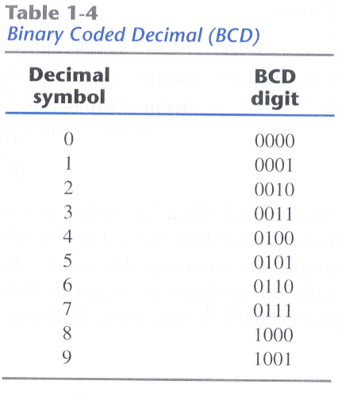
Binary Code-BCD code
decimal decimal
①↓ ③↓
computer – binary → binary
② operation (bcd 사용시 can directly operate)
bcd 사용시 ①,③에서의 convert가 더 간단해진다.(하지만 bit는 더 많이 차지)
- the 4-bit code for one decimal
(185)₁₀ = (0001 1000 0101)_{BCD} = (10111001)₂
BCD Addition
- if the binary sum is greater or equal to 1010, we add 0110 to obtain the correct BCD
ex) 184 0001 1000 0100
+ 576 0101 0111 0110
0111←(carry) 10000 1010
0110 0110
760 0111 0110 0000
4 |  | 0100 |  | 4 |  | 0100 |  | 8 |  | 1000
+5 |  | +0101 |  | +8 |  | +1000 |  | +9 |  | +1001
9 |  | 1001 |  | 12 |  | 1100 |  | 17 |  | 10001
 |  |  |  |  |  | +0110 |  |  |  | +0110
 |  |  |  |  |  | 10010 |  |  |  | 10111

Slide 23
BCD in signed 10’s complement
sign bit (MSB) + : 0000 - : 1001
signed 2’s omplement에서의 +/- 연산과 동일 (end carry 무시)
ex) 375 – 240 = 135
0 375 0000 0011 0111 0101
+ 9 760 1001 0111 0110 0000
1010 ←(carry) 1011 ←(carry) 1101 0101
0110 0110 0110
1 0000 0001 0011 0101
(end carry discard)

Slide 24
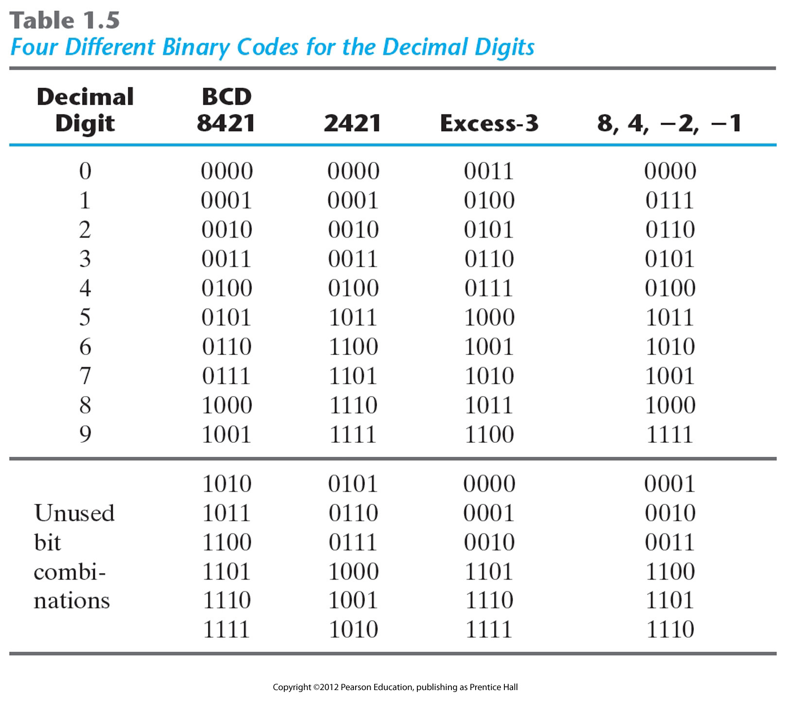
Binary Code-Other Decimal Codes
weighted code : BCD(8421), 84-2-1, 2421
2421,excess-3 code : self-complement code : 9’s complement of a decimal number is obtained directly by chaining 1’s to 0’s and 0’s to 1’s (1’s complement in binary)
ex) <excess-3>
395 0110 1100 1000
604 1001 0011 0111
<2421>
395 0011 1111 1011
604 1100 0000 0100

Slide 25
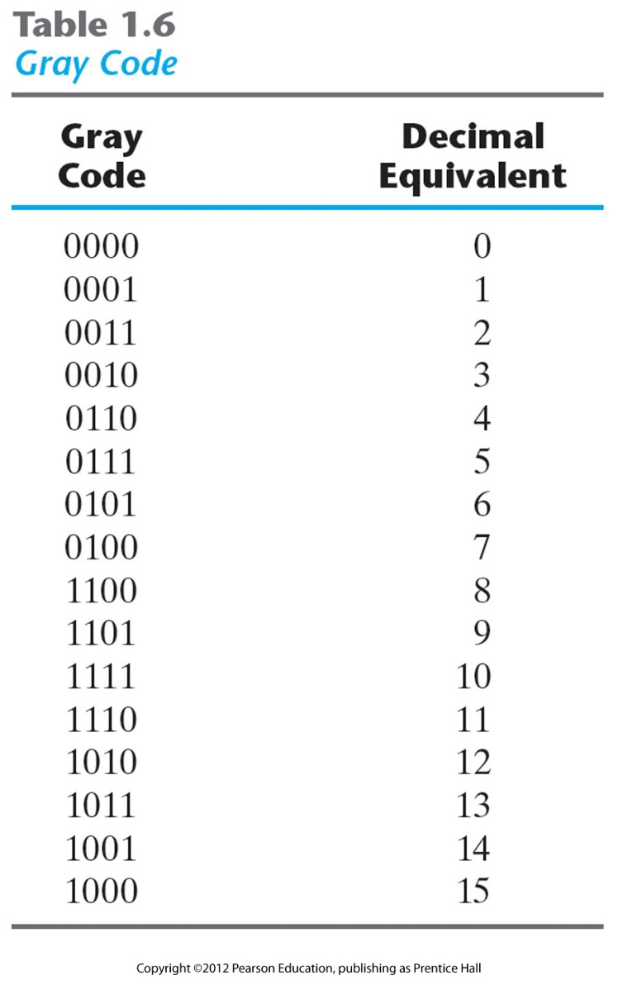
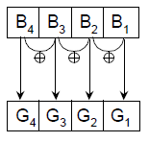
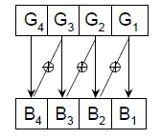
Binary Code-Gray Code
only one bit in the code group changes in going from one number to the next
Binary code -> Gray code
Gray code -> Binary code

Slide 26
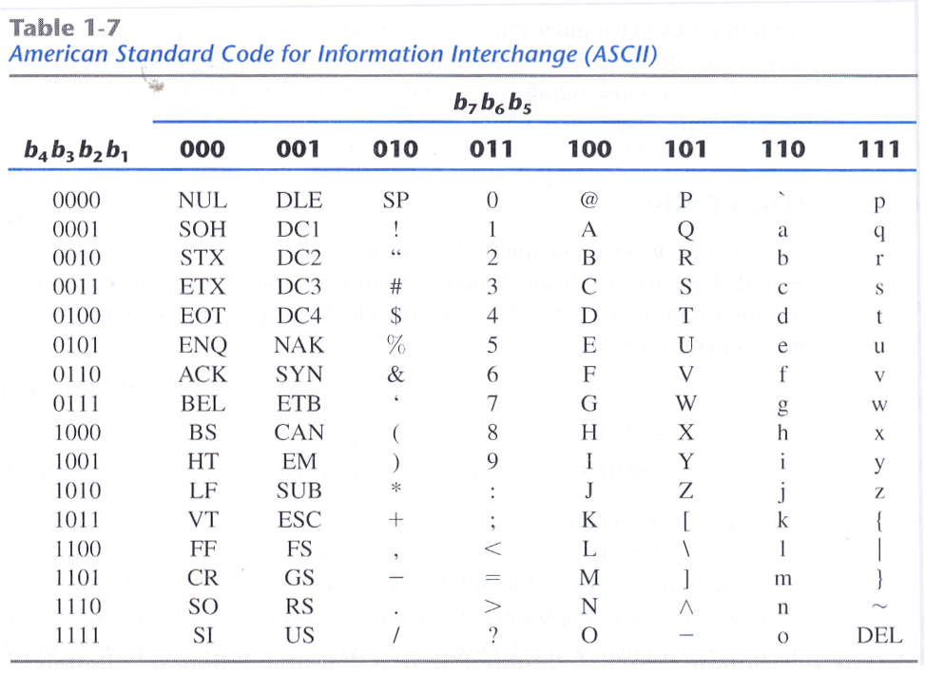
Binary Code- ASCII Character Code

Slide 27
Binary Code ▶ Parity check
Error-Detecting Code
 | With even parity | With odd parity
ASCII A = 1000001 | 01000001 | 11000001
ASCII T = 1010100 | 11010100 | 01010100
In an odd-parity code, the parity bit is specified so that the total number of ones is odd.
In an even-parity code, the parity bit is specified so that the total number of ones is even.
error bit의 갯수가 odd일때만 detect 가능 (even일때는 불가능)

Slide 28
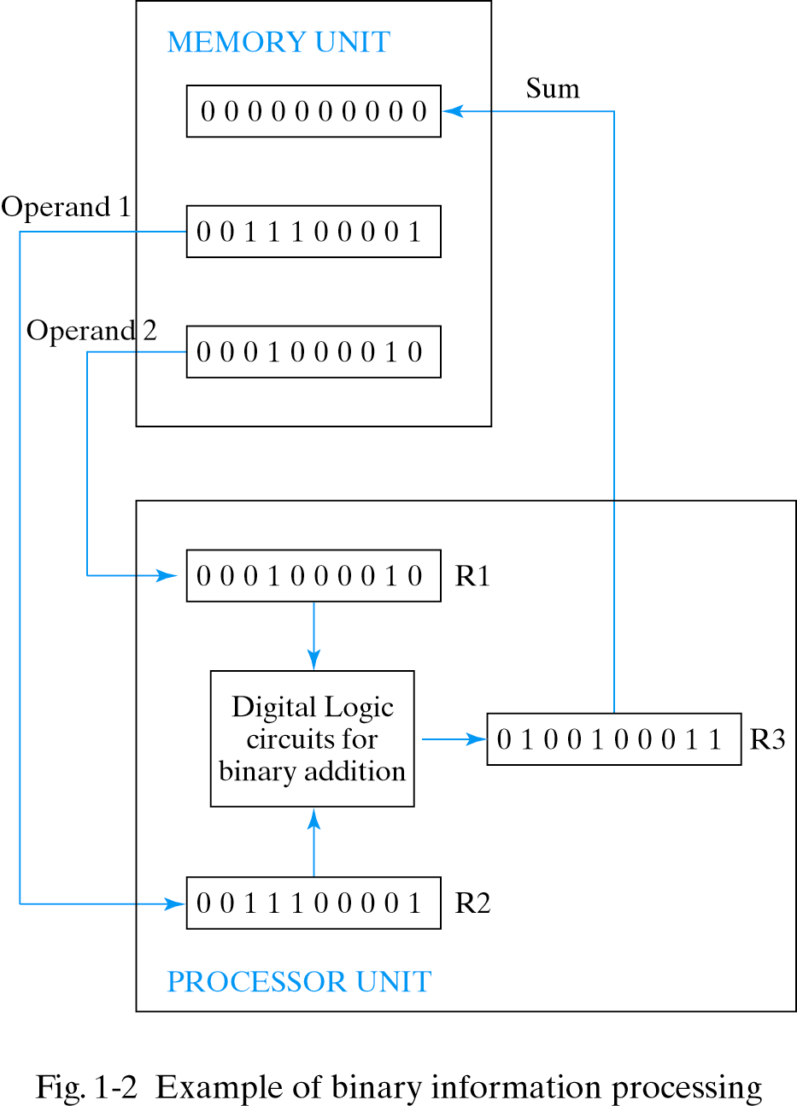
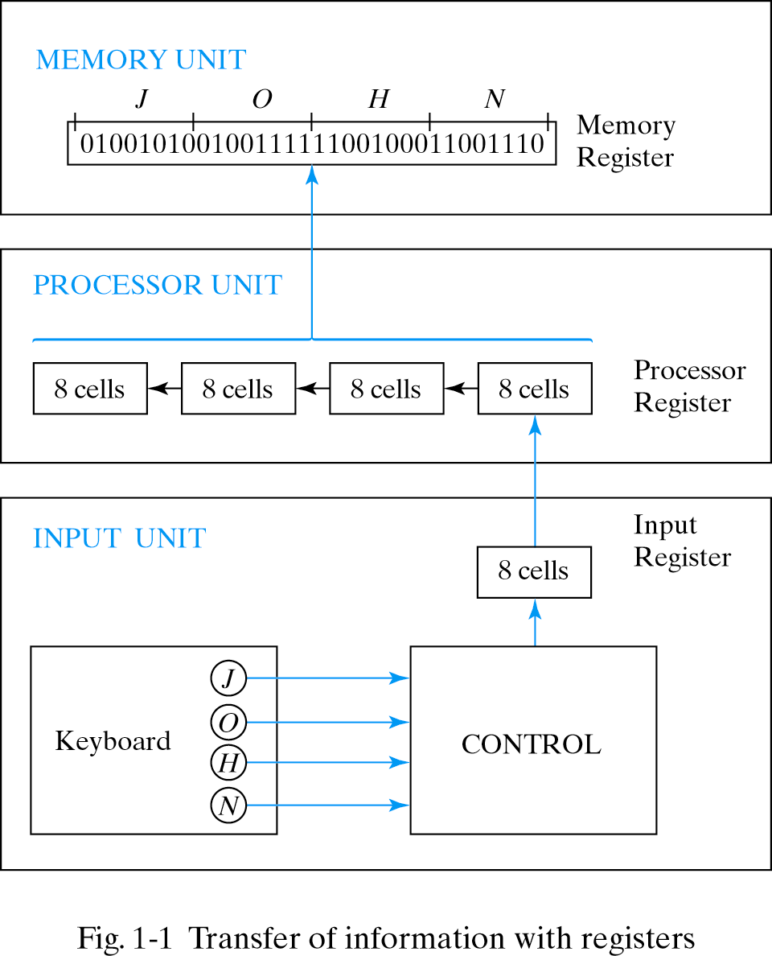
Binary Storage and Registers
Registers – A register with n cells can store any discrete
quantity of information that contains n bits.
Register Transfer

Slide 29
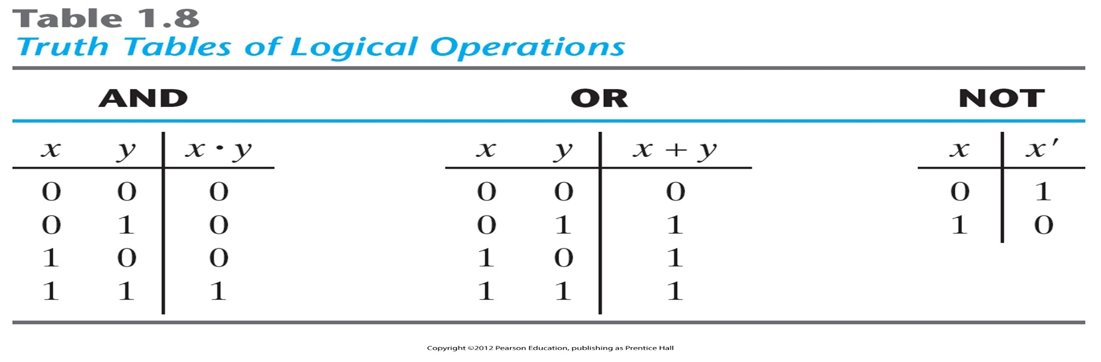
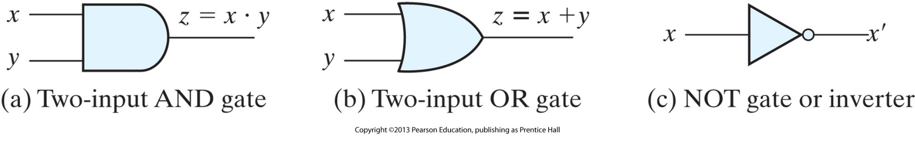
Binary Logic
Definition of Binary Logic (deals with variables that take an two discrete values and with operations that assume logical meaning)
Logic Gates

Slide 30
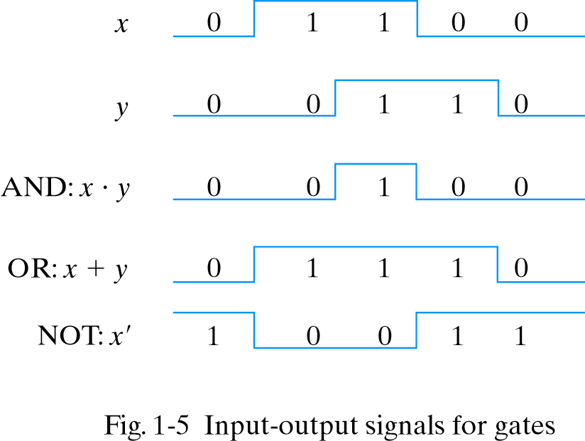
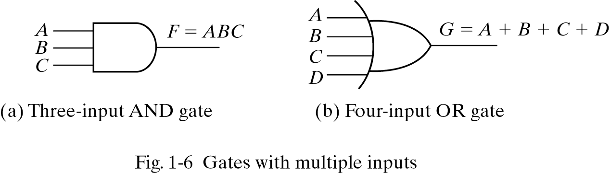
Binary Logic

